Slide 1
Pre assessment Questions
    Identify the correct statement.
      a) Cookies are created on the server and stored by the browser on the client machine.
      b) Cookies are created and stored on the server.
      c) Cookies are created by the browser and stored by the server on the client machine.
      d) Cookies are created and stored by the browser on the client machine.

Slide 2
Pre-assessment Questions (Contd.)
    The setMaxAge(int expiry) method defined in the Cookie class sets:
      a) The maximum age of cookies in milliseconds
      b) The maximum age of cookies in seconds
      c) The maximum age of cookies in minutes
      d) The maximum age of cookies in hours

Slide 3
Pre assessment Questions (Contd.)
    The setMaxInactiveInterval(int interval) method of the HttpSession interface sets:
      a) The maximum age of the session in seconds.
      b) The maximum age of the session in milliseconds.
      c) The maximum time for which a client can remain inactive before the session is invalidated in seconds.
      d) The maximum time for which a client can remain inactive before the session is invalidated in milliseconds.
    Which HttpServletResponse field represents 200 status code?
    a) SC_OK
      b) SC_ACCEPTED
      c) SC_CONTINUE
      d) SC_SWITCHING_PROTOCOLS

Slide 4
Pre assessment Questions (Contd.)
    Identify the correct statement.
      a) The setStatus()method throws IllegalStateExcetion when it is invoked.
      b) The setStatus()method throws IllegalStateExcetion if it is called before the response is committed.
      c) The setStatus()method throws IllegalStateExcetion if it is called after the response is committed.
      d) The setStatus()method never throws IllegalStateExcetion.

Slide 5
Solutions to Pre-assessment Questions
    1. a. Cookies are created by the server and stored by the browser on the client machine.
    2. b. The maximum age of cookies in seconds
    3. c. The maximum time for which a client can remain inactive before the session is invalidated in seconds.
    4. a. SC_OK
    5. c. The setStatus()method throws IllegalStateExcetion if it is called after the response is committed.

Slide 6
Objectives
  In this lesson you will learn about:
  Inter-servlet communication
  Single-threaded and multi-threaded servlets
  Using servlet filters to modify the request and response objects

Slide 7
Inter-Servlet Communication
  A process where two or more servlets communicates with each other to process the client request.
  A servlet can forward the request to another servlet to process the client request.
  A servlet can include the output of another servlet to process the client request.

Slide 8
Inter-Servlet Communication (Contd.)
  Inter-servlet communication using Request Dispatcher
    A Request Dispatcher:
      Is an object of the javax.servlet.RequestDispatcher interface that allows inter-servlet communication.
      Object is used to include the content of another servlet.
      Object is used to forward the request to another servlet.

Slide 9
Inter-Servlet Communication (Contd.)
  Inter-servlet communication using the Request Object
    Stores the calculated data as attribute to the request object in the first servlet.
    Forwards the request to the second servlet using the RequestDispatcher.
    Retrieves the data from the request object and displays the result using the second servlet.

Slide 10
Demonstration-Creating a Customized Error Page
  Problem Statement
    InfoSuper Inc. has created a dynamic Web site. Whenever an error occurs, the stack trace displayed in the browser is difficult to understand. David Wong, the system analyst of the company asks Don Allen, the software programmer of the company to create a customized error page. Whenever an exception is thrown by a servlet, the servlet dispatches the request to the customized error page. The error page then displays the error in the browser in a more understandable format.

Slide 11
Demonstration-Creating a Customized Error Page (Contd.)
  Solution
    Create a servlet that throws an exception and stores the Exception object as an attribute to the request object. The servlet then forwards the request object to an error page.
    Create a servlet that acts as a custom error page to display the error message.
    Compile and deploy the servlets.
    Run the program.

Slide 12
Servlet Threading Model
  The two types of Servlet Threading Model are:
    Multi-threaded Model
    Single-threaded Model

Slide 13
Servlet Threading Model (Contd.)
  Developing Thread-Safe Servlets
    While developing servlets in a multi-threaded model, threading issues needs to be handled to protect the shared resource. Therefore, we need to identify the types of attributes that are inherently thread-safe and the types that need to be guarded for thread safety.

Slide 14
Servlet Threading Model (Contd.)
  Developing Thread-Safe Servlets (Contd.)
    The Various thread-safe capabilities of attributes, methods, and fields in a servlet are:
      init() and destroy() methods
      local variables
      Request attributes
      Context attributes
      Data stored in session attributes
    The two approaches that can be followed for developing thread-safe servlets are:
      Synchronizing block of codes for accessing a shared resource
      Synchronizing methods for accessing a shared resource

Slide 15
Servlet Filters
  Servlet filters:
    Are objects that intercept the requests and response that flow between a client and a servlet.
    Modify the headers and content of a request coming from a Web client and forward it to the target servlet.
    Intercept and manipulate the headers and contents of the response that the servlet sends back.

Slide 16
Servlet Filters (Contd.)
  The advantages of using servlet filters are:
    You can identify the type of request coming from the Web client, such as HTTP and FTP, and invoke the servlet that needs to process the request.
    You can validate a client using servlet filters before the client accesses the servlet.
    You can retrieve the user information from the request parameters to authenticate the user.
    You can use servlet filters to identify the information about the MIME types and other header contents of the request.

Slide 17
Servlet Filters (Contd.)
  Advantages of using servlet filters are (Contd.):
    You can use servlet filters to facilitate a servlet to communicate with the external resources.
    You can use servlet filters to intercept responses and compress it before sending the response to the client.

Slide 18
Servlet Filters (Contd.)
  Programming of filters include:
    Creating Filters
    Deploying Servlet Filters

Slide 19
Servlet Filters (Contd.)
  Creating Filters
    The following code snippet shows a filter which calculates the time taken by a servlet to process the client request:
    public class ProcessingTimeFilter implements Filter {
    public void do Filter(ServletRequest request, ServletResponse response, FilterChain chain) throws IOException, ServletException {
    long service_Start = System.currentTimeMillis();
    chain.doFilter(request, response);
    long service_Stop = System.currentTimeMillis();
    long serviceTime = (service_Stop - service_Start);
    flt_cnfg.getServletContext().log("Time taken to process request is: “ + serviceTime + " milliseconds");
    }}
      Deploying Filters

Slide 20
Servlet Filters (Contd.)
  Deploying Filters include:
    Adding a filter to the Web application
    Mapping the filter to the Web application

Slide 21
Servlet Filters (Contd.)
  Adding the filter to Web application involves:
    Add the filter to the Web application in the similar way as you add a servlet to a Web application using the deploytool.

Slide 22
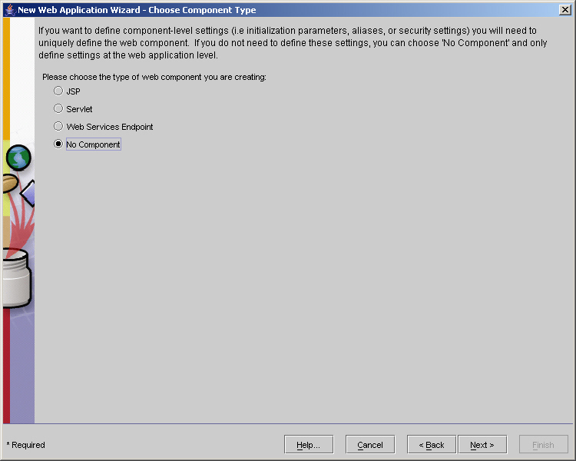
Servlet Filters (Contd.)
    Select the component type as No Component in the New Web Application Wizard - Choose Component Type dialog box of the New Web Application Wizard as shown in the following figure:

Slide 23
Servlet Filters (Contd.)
  Mapping the filter to Web application involves:
    Select the Web application to which you have added the filter class in the J2EE Deploytool window.

Slide 24
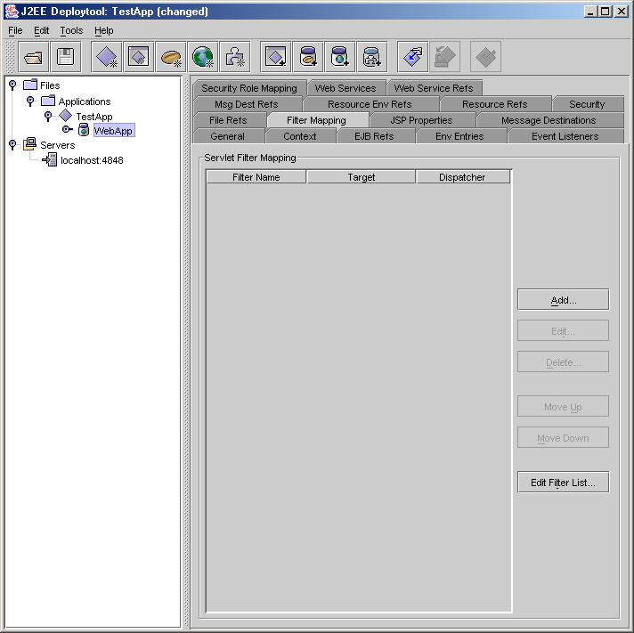
Servlet Filters (Contd.)
      Click the Filter Mapping tab in the right pane of the J2EE Deploytool window to display the Filter Mapping tabbed page, as shown in the following figure:

Slide 25
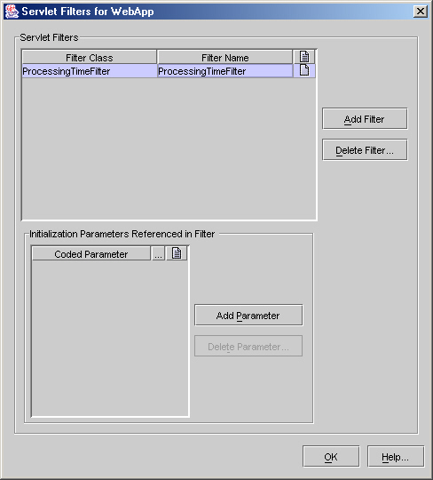
Servlet Filters (Contd.)
    Click the Edit Filter List button to display the Servlet Filters for WebApp dialog box. Click the Add Filter button in the Servlet Filter for WebApp dialog box. Select ProcessingTimeFilter from the drop-down list of the Filter Class column. Specify the name of the filter in the Filter Name column, as shown in the following figure:

Slide 26
Servlet Filters (Contd.)
      Click the OK button to return to the Filter Mapping tabbed page in the J2EE Deploytool window.

Slide 27
Servlet Filters (Contd.)
      Click the Add button under the Filter Mapping tabbed page to display the Add Servlet Filter Mapping dialog box. Select ProcessingTimeFilter from the Filter Name drop-down list. In the Filter Target pane, select the Filter Servlets that match this URL Pattern option and specify /* in the URL Pattern text box. This specifies that the filter needs to intercept all requests and response coming to this Web application. The following figure shows the Add Servlet Filter Mapping dialog box:

Slide 28
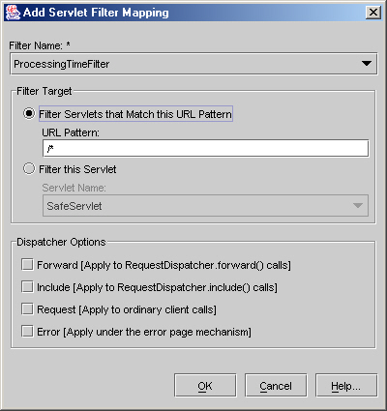
Servlet Filters (Contd.)
      Click the OK button to complete the filter mapping process.

Slide 29
Summary
  In this lesson, you learned:
  Forwarding requests to other servlets using the forward() method of RequestDispatcher.
  Including the content of other servlets in a servlet using the include() method of RequestDispatcher.
  Performing inter-servlet communication using RequestDispatcher and servlet request object.
  Multi-threaded servlet model is the default threading model of a servlet.
  Various functions of a servlet filter are:
    Identifying the type of client browser.
    Identifying the character encoding used by the client browser.

Slide 30
Summary (Contd.)
  Developing servlet filters using Filter interface, FilterConfig interface, ServletRequest interface, and ServletResponse interface.
  Adding filter to a Web application and mapping them to a servlet to filter the contents of a servlet.

